Slide 1
Vector Mechanics For Engineers: Dynamics Twelfth Edition
Copyright © 2020 McGraw Hill , All Rights Reserved.
PROPRIETARY MATERIAL © 2020 The McGraw Hill Inc. All rights reserved. No part of this PowerPoint slide may be displayed, reproduced or distributed in any form or by any means, without the prior written permission of the publisher, or used beyond the limited distribution to teachers and educators permitted by McGraw Hill for their individual course preparation. If you are a student using this PowerPoint slide, you are using it without permission.

Slide 2
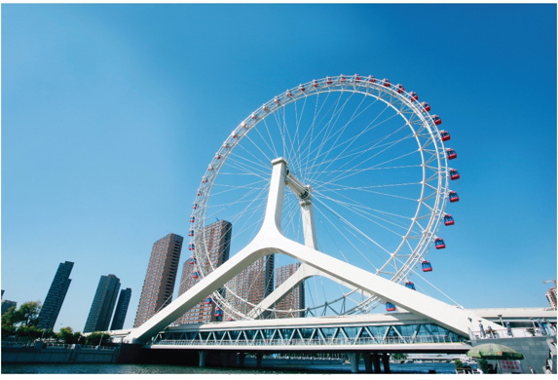
Chapter 14
Systems of Particles

Slide 3
Contents 1
Introduction
Applying Newton’s Law and Momentum Principles
Linear and Angular Momentum
Motion of Mass Center of System of Particles
Angular Momentum About Mass Center
Conservation of Momentum
Sample Problem 14.2
Kinetic Energy
Work-Energy Principle and Conservation of Energy
Impulse Momentum Principle
Sample Problem 14.5
Sample Problem 14.6
Variable Systems of Particles
Steady Stream of Particles. Applications
Steady Stream of Particles
Streams Gaining or Losing Mass
Sample Problem 14.7

Slide 4
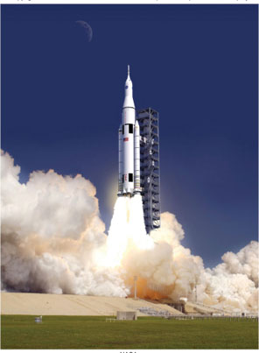

Contents 2
Engineers often need to analyze the dynamics of systems of particles – this is the basis for many fluid dynamics applications, and will also help establish the principles used in analyzing rigid bodies
NASA, ©Lena Kofoed

Slide 5
Introduction
In the current chapter, you will study the motion of systems of particles.
The effective force of a particle is defined as the product of it mass and acceleration. It will be shown that the system of external forces acting on a system of particles is equipollent with the system of m_{i}a_{i} for the various particles.
The mass center of a system of particles will be defined and its motion described.
Application of the work-energy principle and the impulse-momentum principle to a system of particles will be described. Result obtained are also applicable to a system of rigidly connected particles, i.e., a rigid body.
Analysis methods will be presented for variable systems of particles, i.e., systems in which the particles included in the system change.

Slide 6
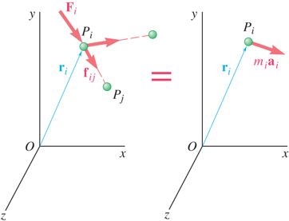
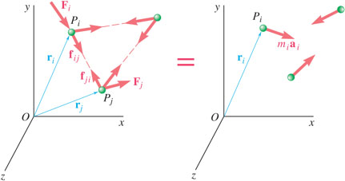
Applying Newton’s Law and Momentum Principles 1
Newton’s second law for each particle P_{i} in a system of n particles,
The system of external and internal forces on a particle is equivalent to the effective force of the particle.
The system of external and internal forces acting on the entire system of particles is equivalent to the system of effective forces.

Slide 7
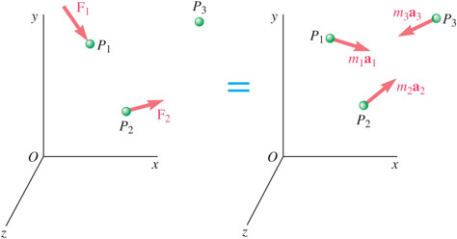
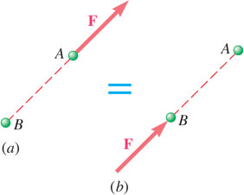
Applying Newton’s Law and Momentum Principles 2
Summing over all the elements,
Since the internal forces occur in equal and opposite collinear pairs, the resultant force and couple due to the internal forces are zero,
The system of external forces and the system of m_{i}a_{i} are equipollent by not equivalent.

Slide 8
Linear & Angular Momentum
Linear momentum of the system of particles,
Angular momentum about fixed point O of system of particles,
Resultant of the external forces is equal to rate of change of linear momentum of the system of particles,
Moment resultant about fixed point O of the external forces is equal to the rate of change of angular momentum of the system of particles,

Slide 9
Motion of the Mass Center of a System of Particles
Mass center G of system of particles is defined by position vector
which satisfies.
Differentiating twice,
The mass center moves as if the entire mass and all of the external forces were concentrated at that point.

Slide 10
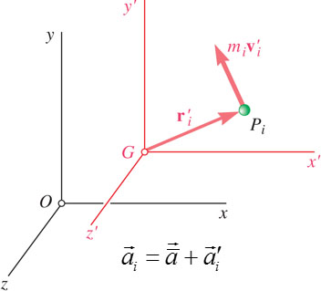
Angular Momentum About the Mass Center 1
The angular momentum of the system of particles about the mass center,
Consider the centroidal frame of reference Gx’y’z’, which translates with respect to the Newtonian frame Oxyz.
The moment resultant about G of the external forces is equal to the rate of change of angular momentum about G of the system of particles.
The centroidal frame is not, in general, a Newtonian frame.

Slide 11
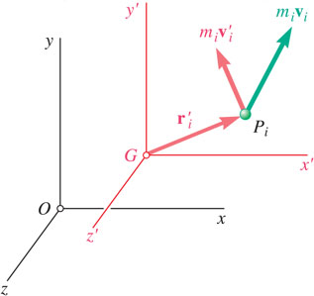
Angular Momentum About the Mass Center 2
Angular momentum about G of particles in their absolute motion relative to the Newtonian Oxyz frame of reference.
Angular momentum about G of the particles in their motion relative to the centroidal Gx’y’z’ frame of reference,
Angular momentum about G of the particle momenta can be calculated with respect to either the Newtonian or centroidal frames of reference.

Slide 12
Conservation of Momentum
If no external forces act on the particles of a system, then the linear momentum and angular momentum about the fixed point O are conserved.
Concept of conservation of momentum also applies to the analysis of the mass center motion,
In some applications, such as problems involving central forces,

Slide 13
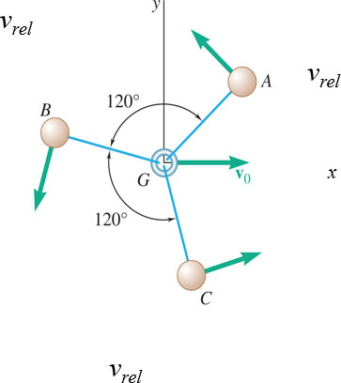
Concept Question 1
Three small identical spheres A, B, and C, which can slide on a horizontal, frictionless surface, are attached to three 200-mm-long strings, which are tied to a ring G. Initially, each of the spheres rotate clockwise about the ring with a relative velocity of v_{rel}.
Which of the following is true?
a) The linear momentum of the system is in the positive x direction.
b) The angular momentum of the system is in the positive y direction.
c) The angular momentum of the system about G is zero.
d) The linear momentum of the system is zero.

Slide 14
Concept Question 2
Three small identical spheres A, B, and C, which can slide on a horizontal, frictionless surface, are attached to three 200-mm-long strings, which are tied to a ring G. Initially, each of the spheres rotate clockwise about the ring with a relative velocity of v_{rel}.
Which of the following is true?
a) The linear momentum of the system is in the positive x direction.
b) The angular momentum of the system is in the positive y direction.
c) The angular momentum of the system about G is zero.
d) The linear momentum of the system is zero.

Slide 15
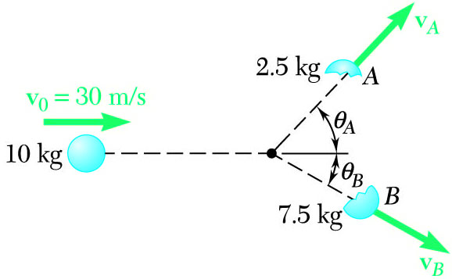
Sample Problem 14.2 1
Strategy:
Since there are no external forces, the linear momentum of the system is conserved.
Write separate component equations for the conservation of linear momentum.
Solve the equations simultaneously for the fragment velocities.
A 10-kg projectile is moving with a velocity of 30 m/s when it explodes into 2.5 and 7.5-kg fragments. Immediately after the explosion, the fragments travel in the directions θ_{A} = 45º and θ_{B} = 30º.
Determine the velocity of each fragment.

Slide 16
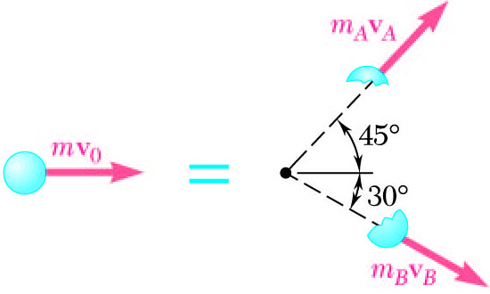
Sample Problem 14.2 2
Modeling and Analysis:
Since there are no external forces, the linear momentum of the system is conserved.
Write separate component equations for the conservation of linear momentum.
x components:
y
y components:
x
Solve the equations simultaneously for the fragment velocities.
Reflect and Think:
As you might have predicted, the less massive fragment winds up with a larger magnitude of velocity and departs the original trajectory at a larger angle.

Slide 17
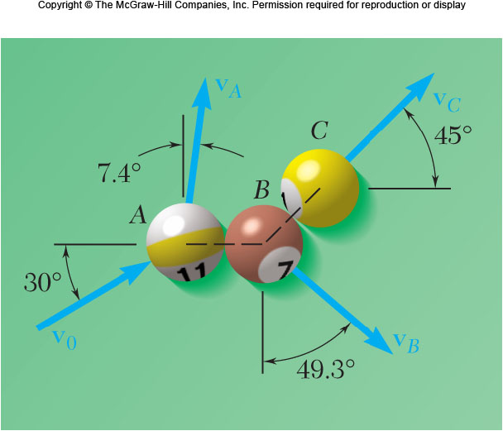
Group Problem Solving 1
v_{A}
Strategy:
Since there are no external forces, the linear momentum of the system is conserved.
v_{C}
Write separate component equations for the conservation of linear momentum.
v₀
v_{B}
Solve the equations simultaneously for the pool ball velocities.
In a game of pool, ball A is moving with a velocity v₀ when it strikes balls B and C, which are at rest and aligned as shown. Knowing that after the collision the three balls move in the directions indicated and that v₀ = 4 m/s and v_{C}= 2 m/s, determine the magnitude of the velocity of (a) ball A, (b) ball B.

Slide 18
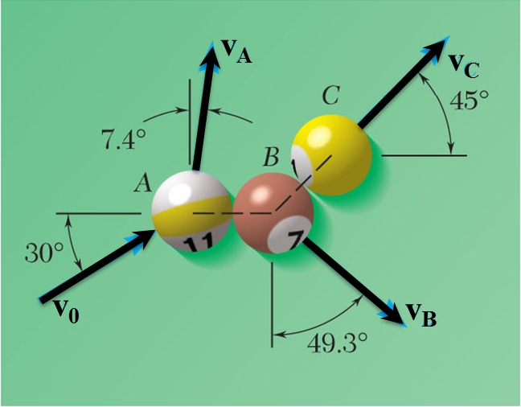
Group Problem Solving 2
Modeling And Analysis:
Write separate component equations for the conservation of linear momentum
x:
(1)
y:
(2)
Two equations, two unknowns - solve
0.65210 (
)
+ 0.75813 (
)
Sub into (1) or (2) to get v_{B}

Slide 19
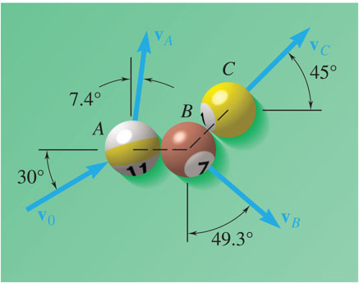
Concept Question 3
Reflect and Think:
In a game of pool, ball A is moving with a velocity v₀ when it strikes balls B and C, which are at rest and aligned as shown.
After the impact, what is true about the overall center of mass of the system of three balls?
The overall system CG will move in the same direction as v₀
The overall system CG will stay at a single, constant point
There is not enough information to determine the CG location

Slide 20
Concept Question 4
Reflect and Think:
In a game of pool, ball A is moving with a velocity v₀ when it strikes balls B and C, which are at rest and aligned as shown.
After the impact, what is true about the overall center of mass of the system of three balls?
The overall system CG will move in the same direction as v₀
The overall system CG will stay at a single, constant point
There is not enough information to determine the CG location

Slide 21
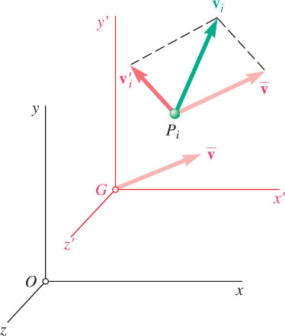
Kinetic Energy
Kinetic energy of a system of particles,
Expressing the velocity in terms of the centroidal reference frame,
Kinetic energy is equal to kinetic energy of mass center plus kinetic energy relative to the centroidal frame.

Slide 22
Work-Energy Principle and Conservation of Energy
Principle of work and energy can be applied to each particle P_{i} ,
represents the work done by the internal forces
and the resultant external force
Principle of work and energy can be applied to the entire system by adding the kinetic energies of all particles and considering the work done by all external and internal forces.
are equal and opposite, the work of these forces will not, in general, cancel out.
If the forces acting on the particles are conservative, the work is equal to the change in potential energy and
which expresses the principle of conservation of energy for the system of particles.

Slide 23
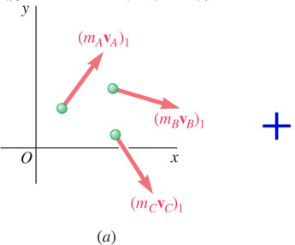
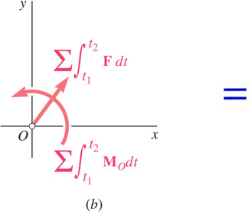
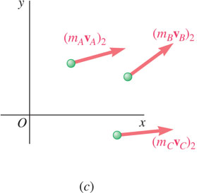
Impulse-Momentum Principle
The momenta of the particles at time t₁ and the impulse of the forces from t₁ to t₂ form a system of vectors equipollent to the system of momenta of the particles at time t₂ .

Slide 24
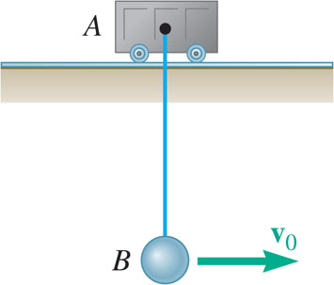
Sample Problem 14.5 1
Strategy:
With no external horizontal forces, it follows from the impulse-momentum principle that the horizontal component of momentum is conserved. This relation can be solved for the velocity of B at its maximum elevation.
Ball B, of mass m_{B}, is suspended from a cord, of length l, attached to cart A, of mass m_{A}, which can roll freely on a frictionless horizontal tract. While the cart is at rest, the ball is given an initial velocity
The conservation of energy principle can be applied to relate the initial kinetic energy to the maximum potential energy. The maximum vertical distance is determined from this relation.
Determine (a) the velocity of B as it reaches it maximum elevation, and (b) the maximum vertical distance h through which B will rise.

Slide 25
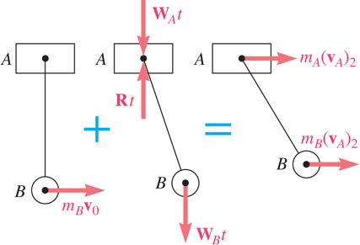
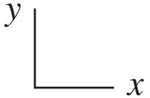
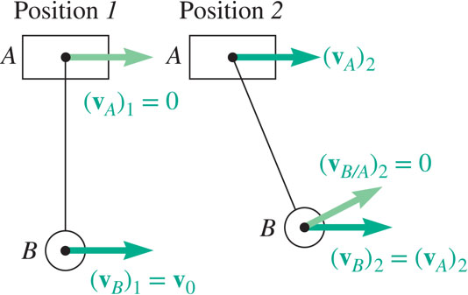
Sample Problem 14.5 2
Modeling and Analysis:
With no external horizontal forces, it follows from the impulse-momentum principle that the horizontal component of momentum is conserved. This relation can be solved for the velocity of B at its maximum elevation.
x component equation:
Velocities at positions 1 and 2 are
(velocity of B relative to A is zero at position 2)

Slide 26
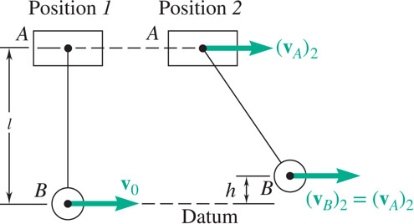
Sample Problem 14.5 3
The conservation of energy principle can be applied to relate the initial kinetic energy to the maximum potential energy.
Position 1 - Potential Energy:
Kinetic Energy:
Position 2 - Potential Energy:
Kinetic Energy:

Slide 27
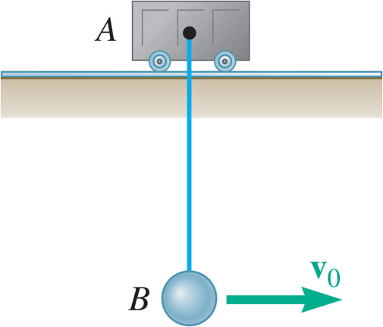
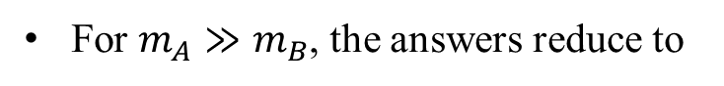
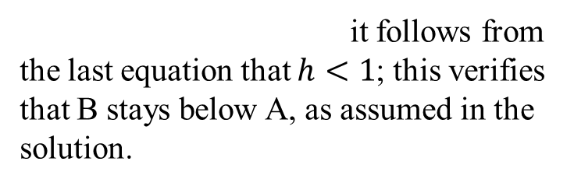
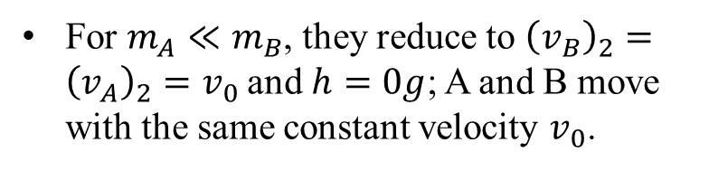
Sample Problem 14.5 4
Strategy:
Recalling that
it follows from the last equation that $h<1$; this verifies that B stays below A, as assumed in the solution.
For $m_{A}≫m_{B}$, the answers reduce to
B oscillates as a simple pendulum with A fixed.
For $m_{A}≪m_{B}$, they reduce to ${\left(v_{B}\right)}_{2}={\left(v_{A}\right)}_{2}=v_{0}$and $h=0g$; A and B move with the same constant velocity $v_{0}$.

Slide 28
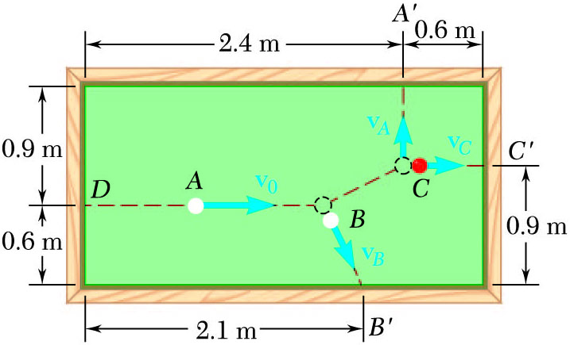
Sample Problem 14.6 1
Strategy:
There are four unknowns: v_{A}, v_{B,x}, v_{B,y}, and v_{C}.
Solution requires four equations: conservation principles for linear momentum (two component equations), angular momentum, and energy.
Ball A has initial velocity v₀ = 3 m/s parallel to the axis of the table. It hits ball B and then ball C which are both at rest. Balls A and C hit the sides of the table squarely at A’ and C’ and ball B hits obliquely at B’.
Assuming perfectly elastic collisions, determine velocities v_{A}, v_{B}, and v_{C} with which the balls hit the sides of the table.
Write the conservation equations in terms of the unknown velocities and solve simultaneously.

Slide 29
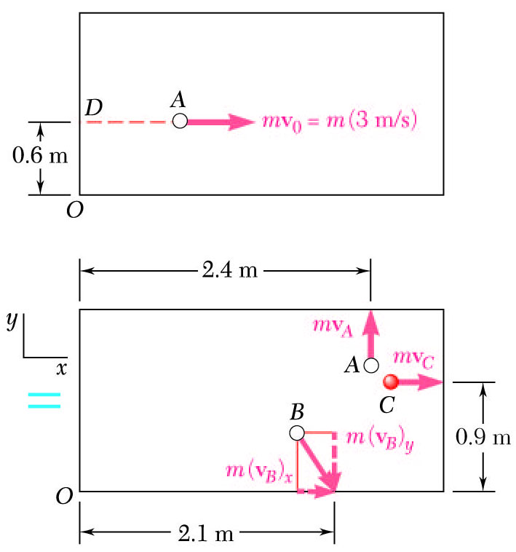
Sample Problem 14.6 2
Modeling and Analysis:
There are four unknowns: v_{A}, v_{B,x}, v_{B,y}, and v_{C}.
The conservation of momentum and energy equations,
Solving the first three equations in terms of v_{C},
Substituting into the energy equation,

Slide 30
Sample Problem 14.6 3
Reflect and Think:
In a real situation, energy would not be conserved, and you would need to know the coefficient of restitution between the balls to solve this problem. We also neglected friction and the rotation of the balls in our analysis, which is often a poor assumption in pool or billiards. We discuss rigid-body impacts in Chapter 17.

Slide 31
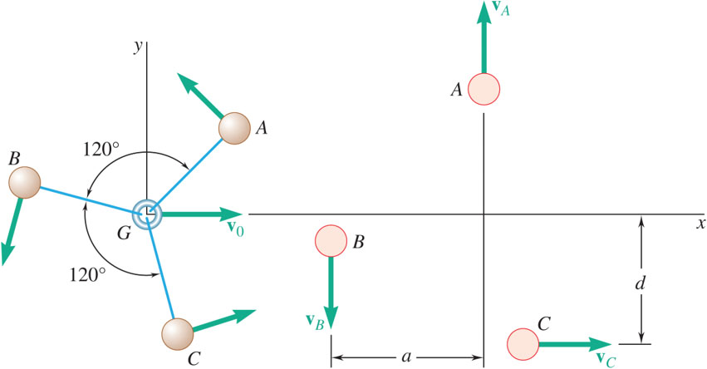
Group Problem Solving 3
Three small identical spheres A, B, and C, which can slide on a horizontal, frictionless surface, are attached to three 200-mm-long strings, which are tied to a ring G. Initially, the spheres rotate clockwise about the ring with a relative velocity of 0.8 m/s and the ring moves along the x-axis with a velocity v₀= (0.4 m/s)i. Suddenly, the ring breaks and the three spheres move freely in the xy plane with A and B following paths parallel to the y-axis at a distance a= 346 mm from each other and C following a path parallel to the x axis. Determine (a) the velocity of each sphere, (b) the distance d.

Slide 32
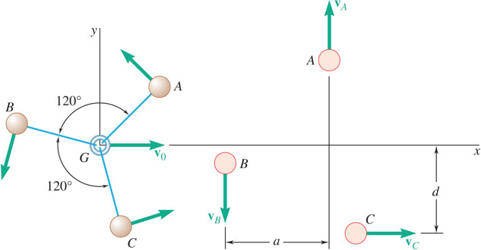
Group Problem Solving 4
Given: v_{Arel}= v_{Brel} = v_{Crel} = 0.8 m/s, v₀= (0.4 m/s)i , L= 200 mm, a= 346 mm
Find: v_{A}, v_{B}, v_{C} (after ring breaks), d
Strategy:
There are four unknowns: v_{A}, v_{B}, v_{B}, d.
Modeling and Analysis:
Apply the conservation of linear momentum equation – find L₀ before ring breaks
Solution requires four equations: conservation principles for linear momentum (two component equations), angular momentum, and energy.
What is L_{f} (after ring breaks)?
Write the conservation equations in terms of the unknown velocities and solve simultaneously.

Slide 33
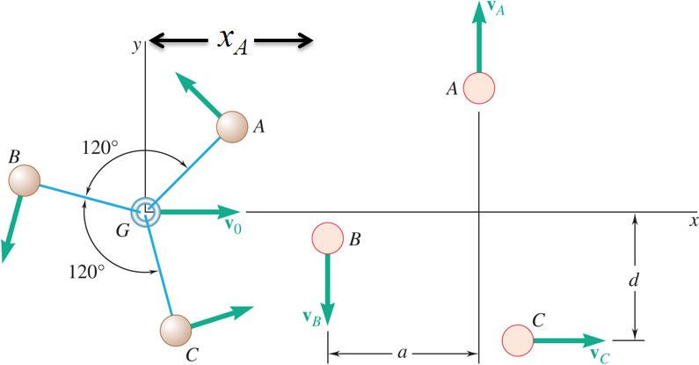
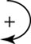
Group Problem Solving 5
Set L₀= L_{f}
From the y components,
From the x components,
Apply the conservation of angular momentum equation
H₀:
H_{f}:
Since v_{A}= v_{B}, and v_{C} = 1.2 m/s, then:

Slide 34
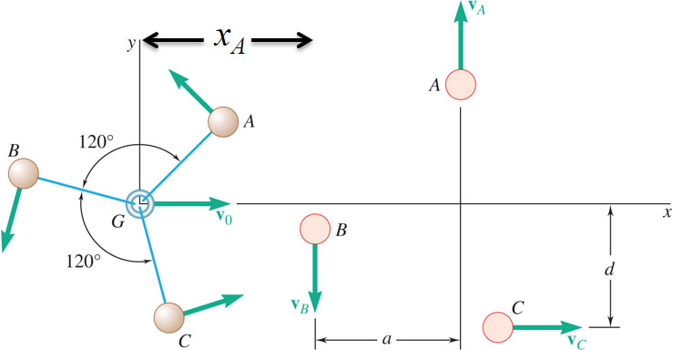
Group Problem Solving 6
Need another equation- try work-energy, where T₀ = T_{f}
T₀:
T_{f}:
Substitute in known values:
Solve for d:

Slide 35
Variable Systems of Particles
Kinetics principles established so far were derived for constant systems of particles, i.e., systems which neither gain nor lose particles.
A large number of engineering applications require the consideration of variable systems of particles, example: hydraulic turbine, rocket engine, etc.
For analyses, consider auxiliary systems which consist of the particles instantaneously within the system plus the particles that enter or leave the system during a short time interval. The auxiliary systems, thus defined, are constant systems of particles.

Slide 36
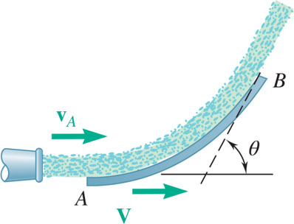
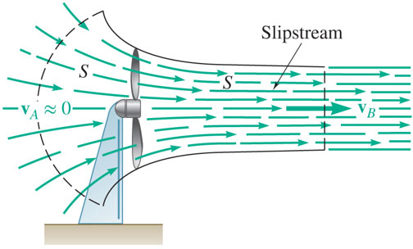
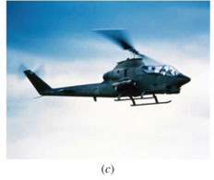
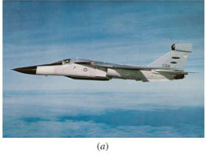
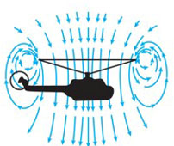
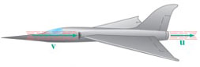
Steady Stream of Particles. Applications
Fan.
Fluid Stream Diverted by Vane or Duct.
Jet Engine.
Helicopter.

Slide 37
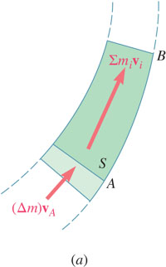
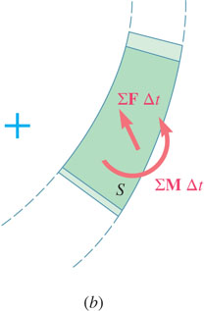
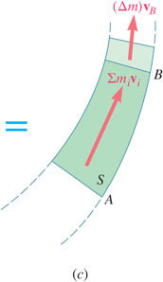
Steady Stream of Particles
System consists of a steady stream of particles against a vane or through a duct.
Define auxiliary system which includes particles which flow in and out over ∆t.
The auxiliary system is a constant system of particles over Δt.

Slide 38
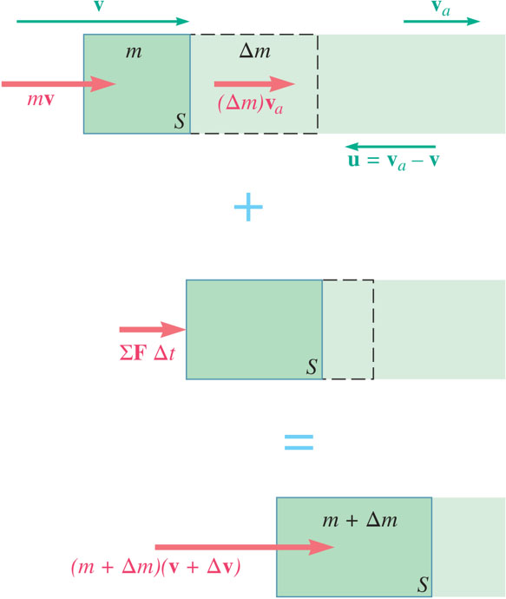
Streams Gaining or Losing Mass
Define auxiliary system to include particles of mass m within system at time t plus the particles of mass Δm which enter the system over time interval Δt.
The auxiliary system is a constant system of particles.

Slide 39
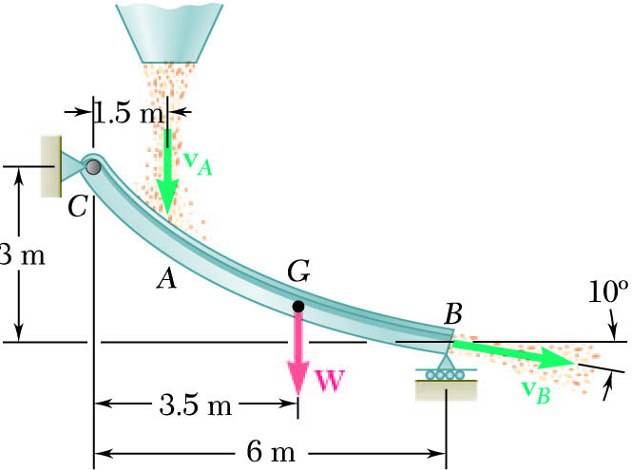
Sample Problem 14.7 1
Strategy:
Define a system consisting of the mass of grain on the chute plus the mass that is added and removed during the time interval Δt.
Apply the principles of conservation of linear and angular momentum for three equations for the three unknown reactions.
Grain falls onto a chute at the rate of 120 kg/s. It hits the chute with a velocity of 10 m/s and leaves with a velocity of 7.5 m/s. The combined weight of the chute and the grain it carries is 3000 N with the center of gravity at G.
Determine the reactions at C and B.

Slide 40
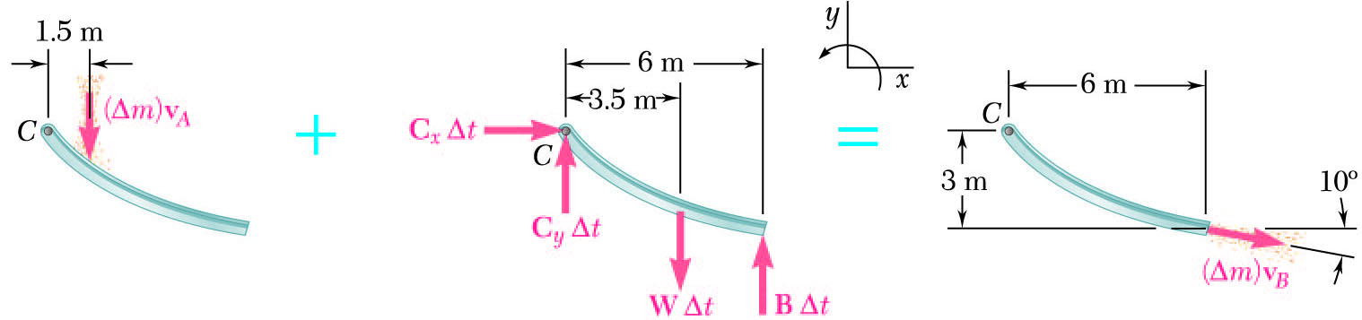
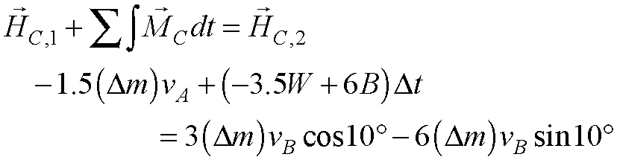
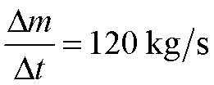
Sample Problem 14.7 2
Modeling and Analysis:
Define a system consisting of the mass of grain on the chute plus the mass that is added and removed during the time interval Δt.
Apply the principles of conservation of linear and angular momentum for three equations for the three unknown reactions.
Solve for C_{x}, C_{y}, and B with

Slide 41
Sample Problem 14.7 3
Reflect and Think:
This kind of situation is common in factory and storage settings. Being able to determine the reactions is essential for designing a proper chute that will support the stream safely. We can compare this situation to the case when there is no mass flow, which results in reactions of B_{y} = 1750 N, C_{y} = 1250 N, and C_{x} = 0 N.

Slide 42
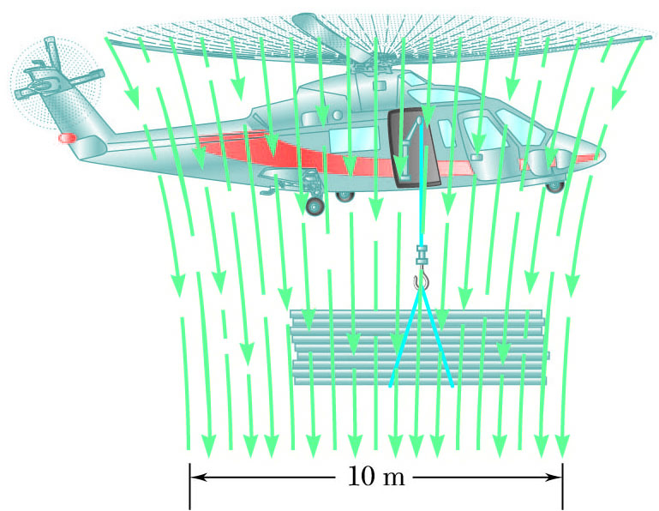
Group Problem Solving 7
Strategy:
Calculate the time rate of change of the mass of the air.
Determine the thrust generated by the airstream.
Use this thrust to determine the maximum load that the helicopter can carry.
The helicopter shown can produce a maximum downward air speed of 25 m/s in a 10-m-diameter slipstream. Knowing that the weight of the helicopter and its crew is 18 kN and assuming ρ = 1.21 kg/m³ for air, determine the maximum load that the helicopter can lift while hovering in midair.

Slide 43
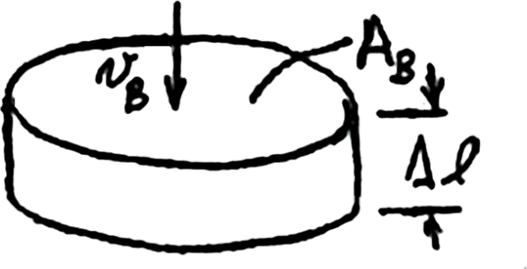
Group Problem Solving 8
Modeling and Analysis: Given: v_{B} = 25 m/s, W= 18,000 N, ρ = 1.21 kg/m³
Find: Max load during hover
Choose the relationship you will use to determine the thrust
Calculate the time rate of change (dm/dt) of the mass of the air.
A_{B} is the area of the slipstream
v_{B} is the velocity in the slipstream.
Well above the blade, v_{A} ≈ 0
14 - 43

Slide 44



Group Problem Solving 9
Use the relationship for dm/dt to determine the thrust
W_{H}
W_{P}
Use statics to determine the maximum payload during hover
W = 41,400 N

Slide 45

Concept Question 5
Reflect and Think: In the previous problem with the maximum payload attached, what happens if the helicopter tilts (or pitches) forward?
a) The area of displaced air becomes smaller.
b) The volume of displaced air becomes smaller.
c) The helicopter will accelerate upward.
d) The helicopter will accelerate forward.

Slide 46
Concept Question 6
Reflect and Think: In the previous problem with the maximum payload attached, what happens if the helicopter tilts (or pitches) forward?
a) The area of displaced air becomes smaller.
b) The volume of displaced air becomes smaller.
c) The helicopter will accelerate upward.
d) The helicopter will accelerate forward.
*The helicopter will also accelerate downward

Slide 47
End of Chapter 14

